Slide 1
FPGA
A Field-Programmable Gate Array (FPGA) is an integrated circuit that can be configured by the user to emulate any digital circuit as long as there are enough resources.
The FPGA configuration is generally specified using a hardware description language (HDL)
An FPGA can be seen as an array of Configurable Logic Blocks (CLBs) connected through programmable interconnect (Switch Boxes).
*
1

Slide 2
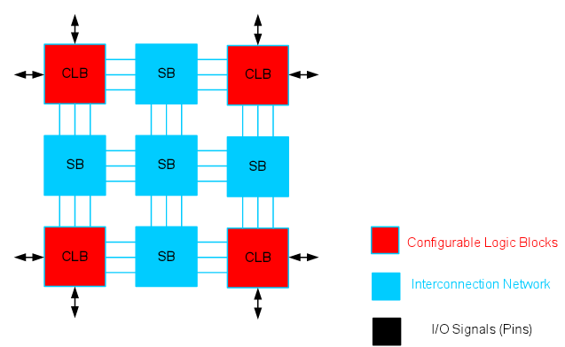
FPGA structure

Slide 3
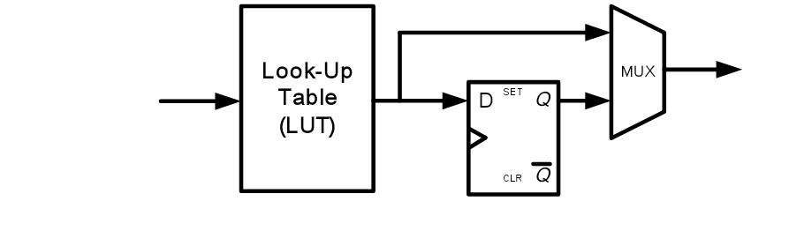

Simplified CLB Structure

Slide 4
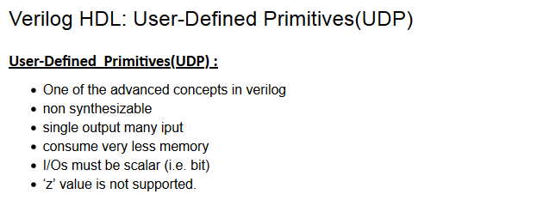
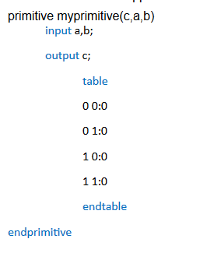
HDL user defined primitives

Slide 5
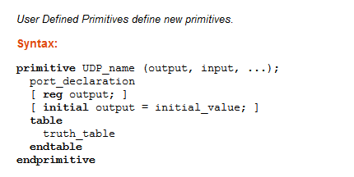
HDL user defined primitives

Slide 6
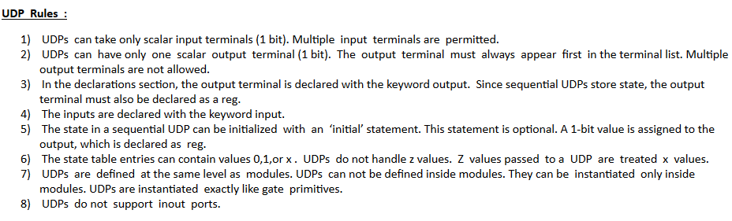
HDL user defined primitives

Slide 7
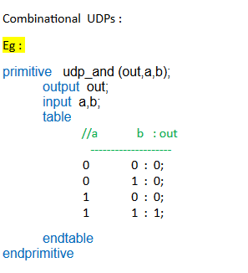
HDL user defined primitives

Slide 8
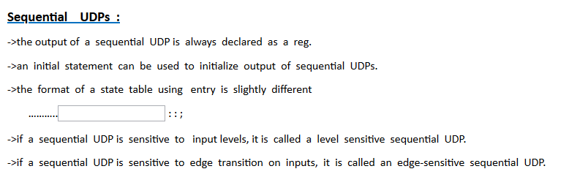
HDL user defined primitives

Slide 9
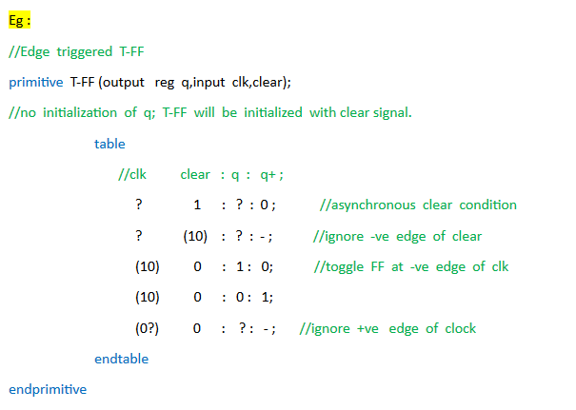
Sequential Level Sensitive UDP’s example

Slide 10
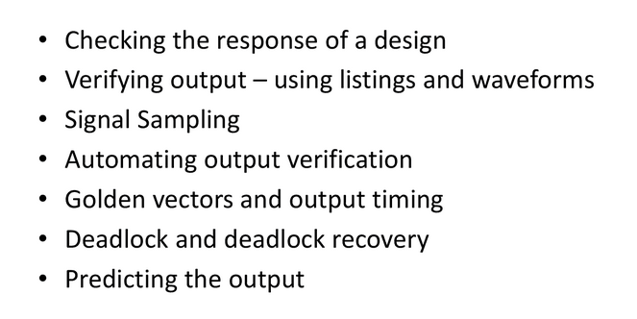
Stimulus to the design

Slide 11
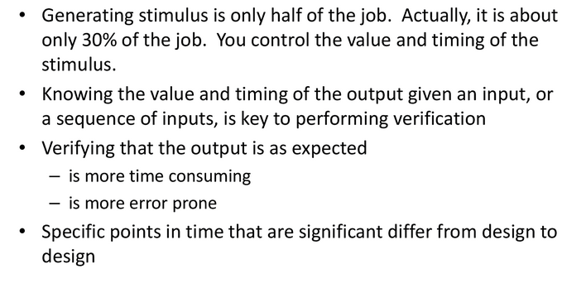
VERIFYING OUTPUT

